Slide 1
XAMPP Installation
Dr. Farshid Keivanian

Slide 2
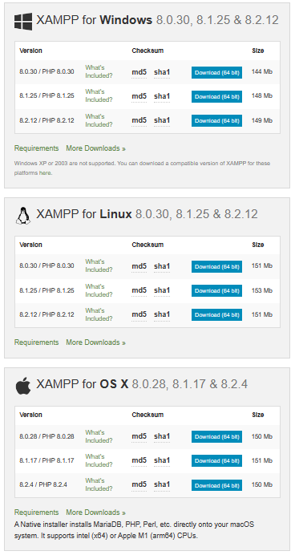
Complete the following tasks: Task 1: Install XAMPP on Windows: A popular PHP and HTML development environment that allows you to run web codes locally on your computer. It includes Apache server, MySQL, and PHP. You can download it from the official XAMPP website, install it, and place your PHP files in the htdocs folder. https://www.apachefriends.org/de/download.html * Or Install MAMP: Similar to XAMPP, MAMP is another local server environment primarily used on MacOS and Windows. After installing MAMP, you can put your PHP files in the htdocs folder.

Slide 3
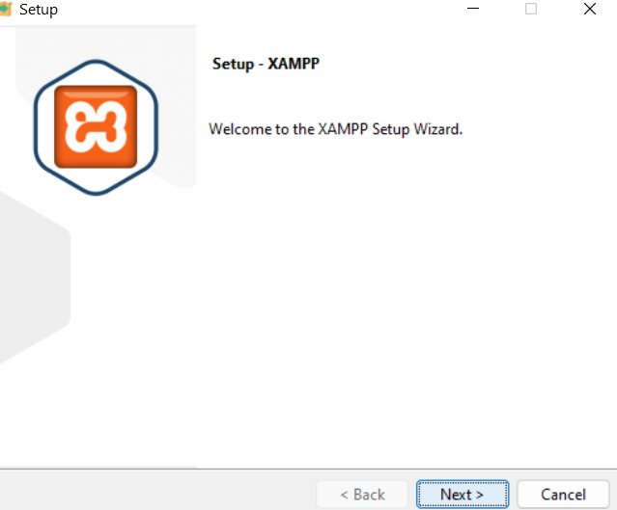
Complete the following tasks: Task 1: Install Xampp as the webserver on your systems and test it. https://www.apachefriends.org/de/download.html

Slide 4
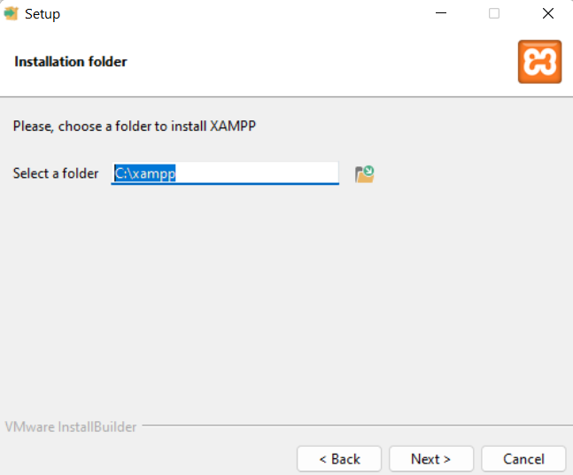
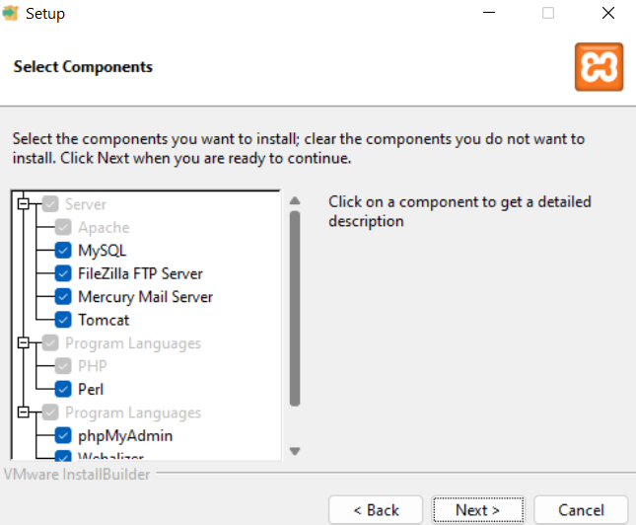

Slide 5
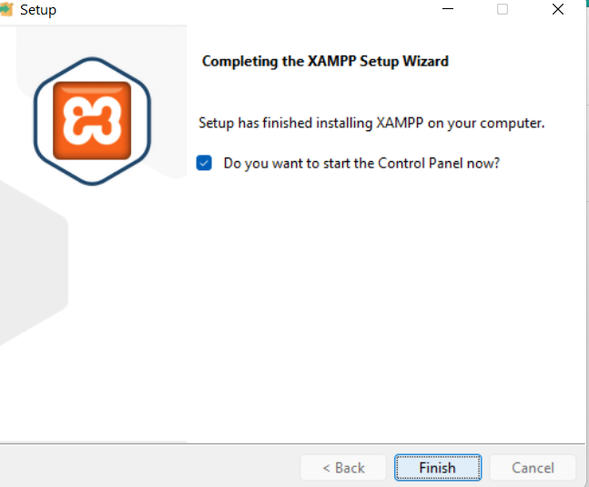

Slide 6
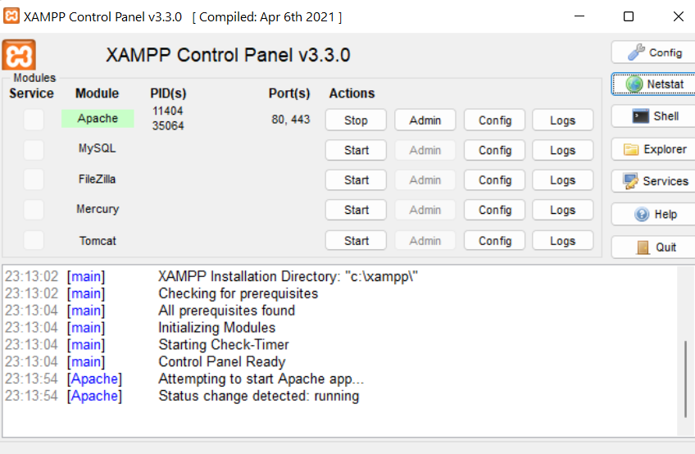

Slide 7
Download XAMPP for macOS:
Visit the Apache Friends website at apachefriends.org.
Click on "XAMPP for OS X" and download the installer.
2. Install XAMPP:
Open the downloaded file (a DMG file).
Drag and drop the XAMPP icon into your Applications folder as instructed by the installer.
3. Launch XAMPP:
Go to your Applications folder and open XAMPP.
You might need to grant security permissions to open XAMPP since it was downloaded from the Internet. You can do this from the 'Security & Privacy' settings in the System Preferences.
4. Manage Servers:
Use the XAMPP Control Panel to start/stop Apache, MySQL, and other services. You can also check the status of these services here.
Click on the "Manage Servers" tab, and then you can start or stop individual services like Apache, MySQL, etc.
5. Access Your Local Server:
Once Apache starts, you can access your local server by going to http://localhost in your web browser.
You can place your website files in the htdocs folder inside the XAMPP directory to serve them through the local server.
6. Use phpMyAdmin:
If you need to manage databases, XAMPP includes phpMyAdmin.
Access phpMyAdmin by visiting http://localhost/phpmyadmin in your browser.
These steps will get XAMPP up and running on your Mac. This setup is excellent for developing and testing web applications locally before deploying them to a live server.

